Slide 1
12. Graph
A Brief Introduction to the Graph Theory

Slide 2
Graphs
A graph is a collection of vertices (or nodes) and the connections between them
A simple graph G = (V, E) consists of a nonempty set V of vertices and a possibly empty set E of edges, each edge being a set of two vertices from V
A directed graph, or a digraph, G = (V, E) consists of a nonempty set V of vertices and a set E of edges (also called arcs), where each edge is a pair of vertices from V
Initially called Network

Slide 3
Definition: Graph
G is an ordered triple G:=(V, E, f)
V is a set of nodes, points, or vertices.
E is a set, whose elements are known as edges or lines.
f is a function
maps each element of E
to an unordered pair of vertices in V.

Slide 4
Definitions
Vertex/node
Basic Element
Drawn as a node or a dot.
Vertex set of G is usually denoted by V(G), or V
Edge
A set of two elements
Drawn as a line connecting two vertices, called end vertices, or endpoints.
The edge set of G is usually denoted by E(G), or E.

Slide 5
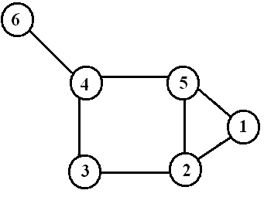
Example
V:={1,2,3,4,5,6}
E:={{1,2},{1,5},{2,3},{2,5},{3,4},{4,5},{4,6}}

Slide 6
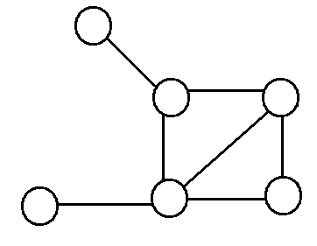
Simple Graphs
Simple graphs are graphs without multiple edges or self-loops.

Slide 7
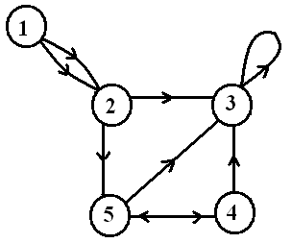
Directed Graph (digraph)
Edges have directions
An edge is an ordered pair of nodes
loop
multiple arc
arc
node

Slide 8
Weighted graphs
1.2
2
1
2
3
1
2
3
.2
.5
1.5
5
3
.3
1
4
5
6
4
5
6
.5
is a graph for which each edge has an associated weight, usually given by a weight function w: E → R.

Slide 9
Why Graph Theory?
Representing a problem as a graph can provide a different point of view
Representing a problem as a graph can make a problem much simpler
More accurately, it can provide the appropriate tools for solving the problem

Slide 10
What is Graph theory?
Graph theory provides a set of techniques for analysing graphs
Graph theory provides techniques for analysing Complex System’ s structure, e.g., a system of interacting agents, represented as a network
Applying graph theory to a system means using a graph-theoretic representation

Slide 11
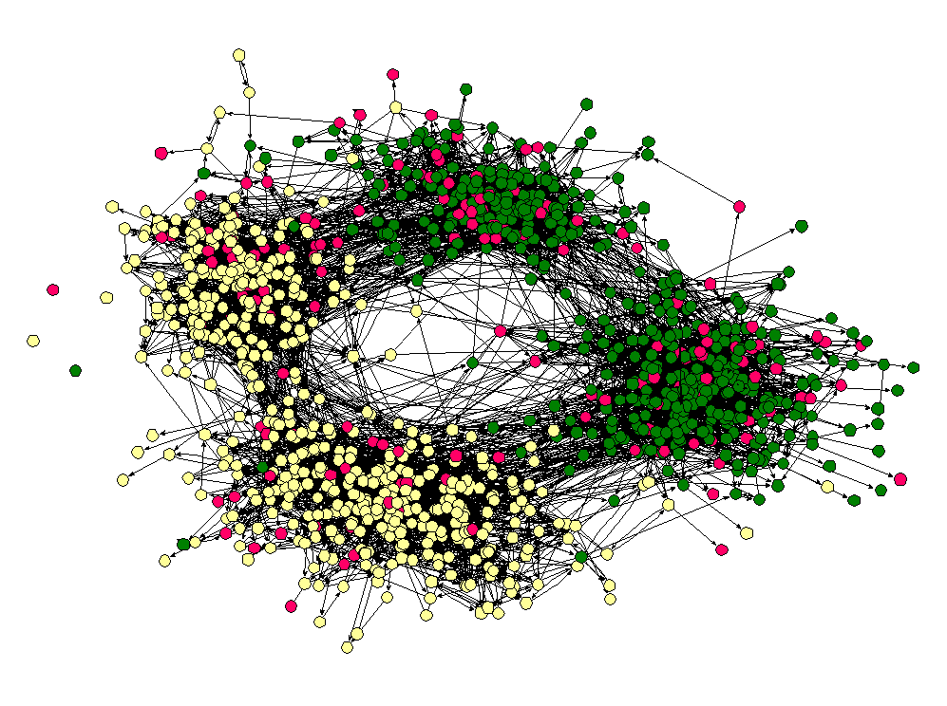
Friendship Network

Slide 12
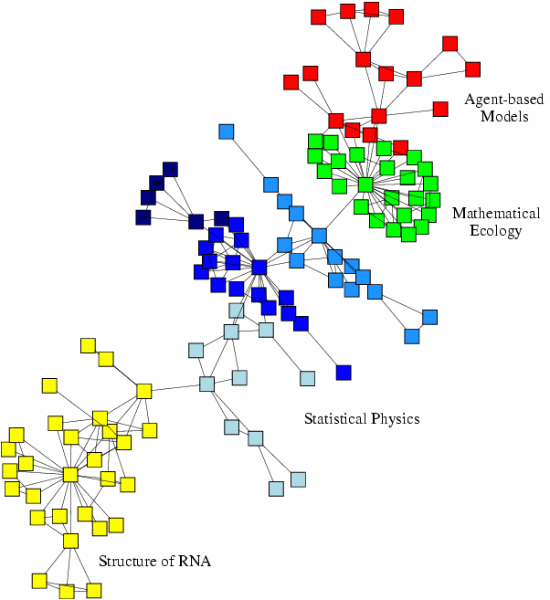
Scientific collaboration network

Slide 13
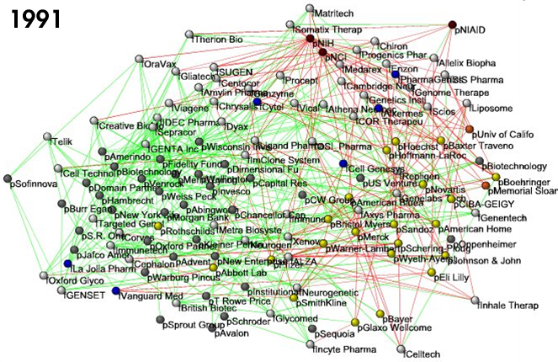
Business ties in US biotech-industry

Slide 14
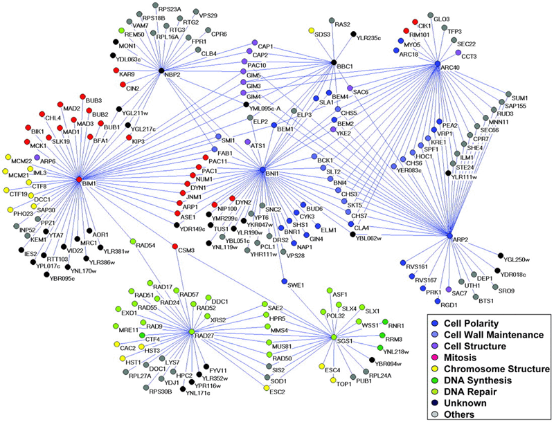
Genetic interaction network

Slide 15
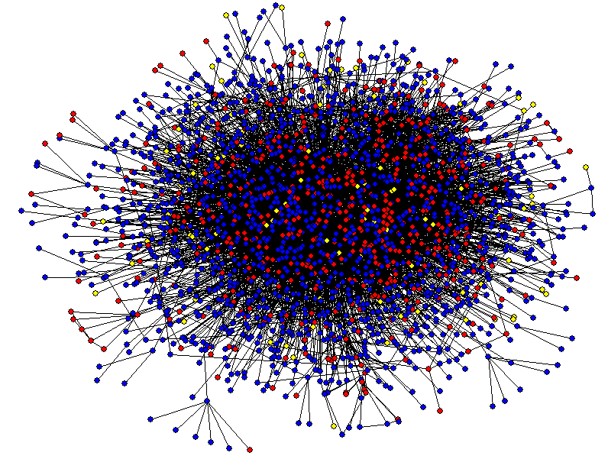
Protein-Protein Interaction Networks

Slide 16
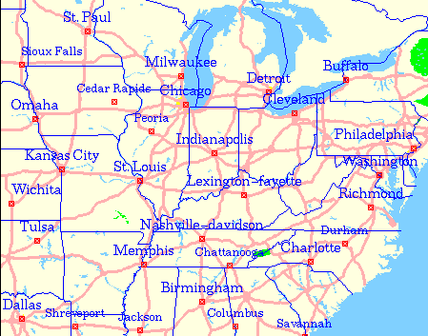
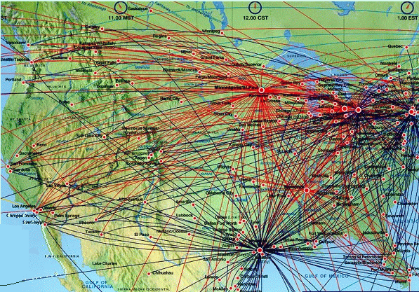
Transportation Networks

Slide 17
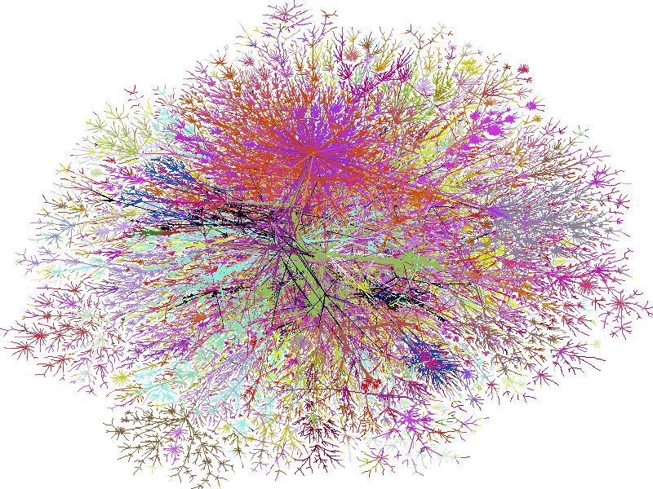
Internet

Slide 18
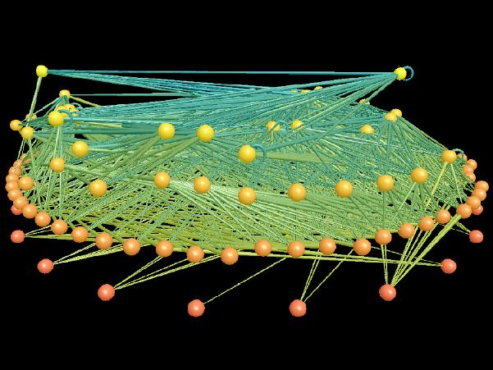
Ecological Networks

Slide 19
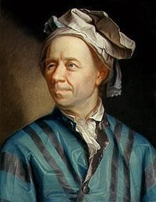
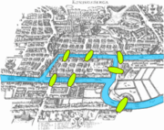
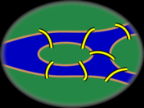
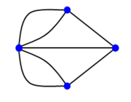
Graph Theory - History
Leonhard Euler's paper on “Seven Bridges of Königsberg” ,
published in 1736.

Slide 20
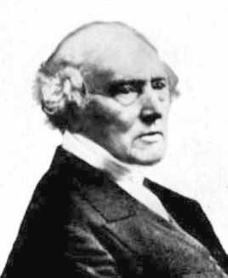
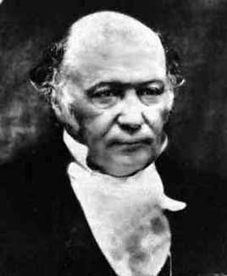
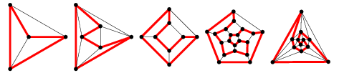
Graph Theory - History
Thomas P. Kirkman William R. Hamilton
Hamiltonian cycles in Platonic graphs

Slide 21
Graph Traversals
Depth-first search (DFS) algorithm
Each vertex v is visited and then each unvisited vertex adjacent to v is visited
Breadth-first search (BFS) algorithm
Start from one vertex, say v: Visit v;
then visit all unvisited vertices v₁, v₂,…, v_{k} adjacent to v; and
then visit all unvisited vertices adjacent to v₁, …

Slide 22
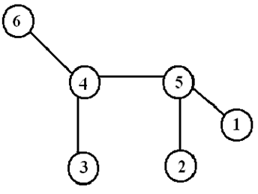
Graph Traversals (continued)
A spanning tree in a connected graph G is a subgraph of G that includes every node and is also a tree.
Spanning tree algorithm is one that, for a given graph, generates a tree (or a forest, a set of trees) that includes or spans over all vertices of the original graph

Slide 23
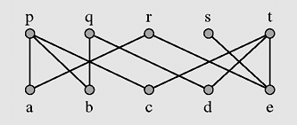
Matching (continued)
Figure 8-26 Matching five applicants with five jobs

Slide 24
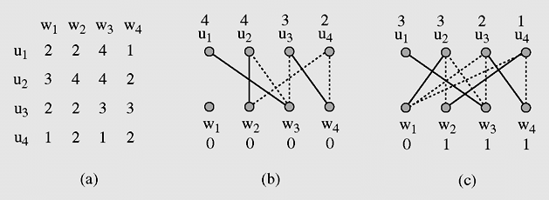
Assignment Problem
In a weighted graph, find a matching with the maximum total weight.
Figure 8-31 An example of application of the optimalAssignment() algorithm

Slide 25
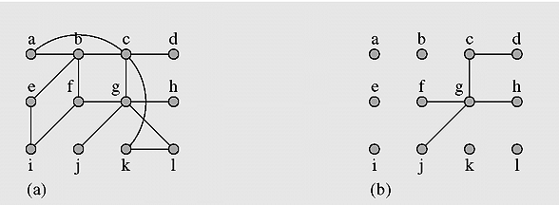
The Chinese Postman Problem
A postman picks up mails from the post office, delivers the mails to houses in a certain area, and returns to the post office.
The walk should have the shortest distance when traversing each street at least once.
Model uses a graph G whose edge represent streets (and the length / distance), and vertices represent street corners in which he wants to find a closed walk.
Figure 8-35 Solving the Chinese postman problem

Slide 26
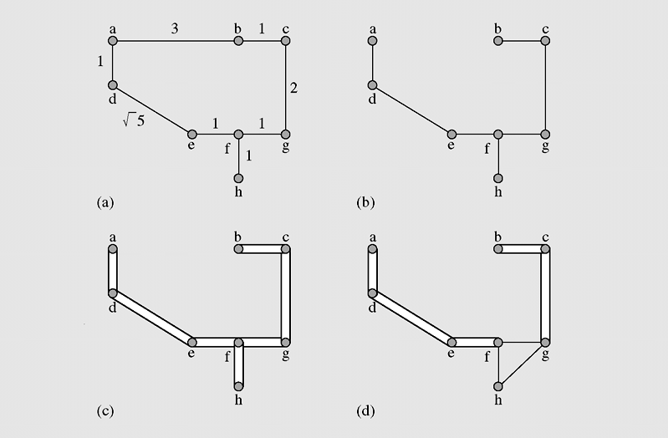
The Traveling Salesman Problem
TSP consists of finding a minimum tour, i.e., in visiting once each city from a set of cities and then returning home so that the total distance traveled is minimum.
Figure 8-38 Using a minimum spanning tree to find a minimum salesman tour

Slide 27
Shortest Paths
A path is a walk where all the edges and all the nodes are different.
A shortest path is a path with the minimum length between two nodes.
Example
1,5,4,6
Shortest path between 1 and 6
a path of length 4.

Slide 28
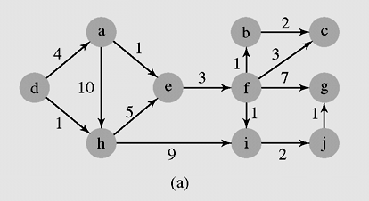
Shortest Paths (continued)
Figure 8-7 An execution of DijkstraAlgorithm()

Slide 29
Summary
Why use graphs
Network design
Analysis of complex interacting systems of systems:
Social networks, Internet, etc.
Performance analysis and simulation including vulnerability analysis
General definitions
A graph is a collection of vertices (or nodes) and the connections between them
Graph representation
graph traversal algorithms
DFS, BFS
Dijkstra’s shortest path algorithm
Many applications

